Slide 1
Booting process

Slide 2
Windows Booting Process
BIOS
POST
Boot Loader Process
Detect and configure hardware phase
Kernel loading phase
Logon phase

Slide 3
BIOS
BIOS stands for Basic Input/output System
Performs some system integrity checks
Searches, loads, and executes the boot loader program.
It looks for boot loader in floppy, cd-rom, or hard drive. You can press a key (typically F12 of F2, but it depends on your system) during the BIOS startup to change the boot sequence.
Once the boot loader program is detected and loaded into the memory, BIOS gives the control to it.
So, in simple terms BIOS loads and executes the MBR boot loader.

Slide 4
POST
POST stands for Power On Self Test phase
The pre-boot sequence begins when the power is turned on.
The computer runs Power-On Self Test(POST) routines to determine the amount of physical memory and the other hardware components present
The computer’s BIOS locates the boot device, and then loads and runs the Master Boot Record(MBR)

Slide 5
MBR
MBR stands for Master Boot Record.
An MBR is generally 512 Bytes in size and consists of bootstrap code and partition table that is 64 bytes.
Every partition entry is 16 bytes in size making the no of partitions in MBR based hard disk limited to only 4.
MBR loads the operating system loader file, Ntldr

Slide 6
Boot loader phase
During the Initial Boot Loader phase, the operating system loader file, Ntldr, switches the microprocessor from the real mode.
640k of RAM is reserved for MS-DOS and rest is designated as extended memory, to 32-bit flat memory mode.
Windows uses all of the available memory. Ntldr starts the build-in mini-file system drivers, so that it can find partitions formatted to FAT or to NTFS and begin the startup process on them.

Slide 7
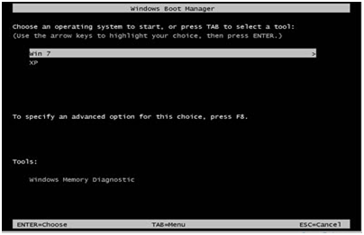
Boot Loader Phase
During the Operating System Selection Phase, if there are multiple operating systems installed on the computer.
The Boot.ini file is configured to present a list of operating systems, the Please select operating System To Start menu appears so that the user can select a system.
If Windows XP is chosen, Ntldr runs Ntdetect.com. If a non-windows operating system is chosen, Ntldr runs Boot sect. dos and relinquishes control of the system. If the user makes no selection, the default operating system loads.
Notes:
Usar para separador de capitulos . Seria bom ter esta versao em vermelho e verde tb..

Slide 8

Detect and Configure hardware phase
During the Hardware Detection phase, Ntdetect.com collects a list of currently installed hardware components and returns the list to Ntldr.
This list will later be used to create the Hardware key in the registry.
The components detected include bus and adaptor types, video adaptors, communications ports, parallel ports , etc. floating-point coprocessors, removable media, keyboards, and pointing devices.
Notes:
O Logo de espadas deve ter mais espaço das pontas abaixo. Sugerir outros tipos de imagens/ telefone, fones.

Slide 9
KERNEL LOADING PHASE
During the kernel load sequence, the operating system components are loaded into memory.
Ntldr loads Ntoskrnl.exe, containing the Windows XP kernel, but does not initialize it.
Ntldr then loads the HAL.dll file. Next, the HKEY_LOCAL_MACHINE\SYSTEM registry key loads, and Ntldr reads the SELECT key to determine which control set to load. Control sets are areas of the registry that contain the low-level configuration for the system, such as the list of device drivers and services to start.
If the system includes any BIOS-disabled SCSI drives. Windows will load Ntbootdd.sys device driver

Slide 10
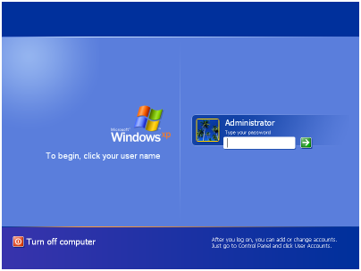
LOGON SEQUENCE
During the logon sequence, Winlogon.exe starts the Local Security Authority (LSA).

